Slide 1

Connecting to peers

Slide 2


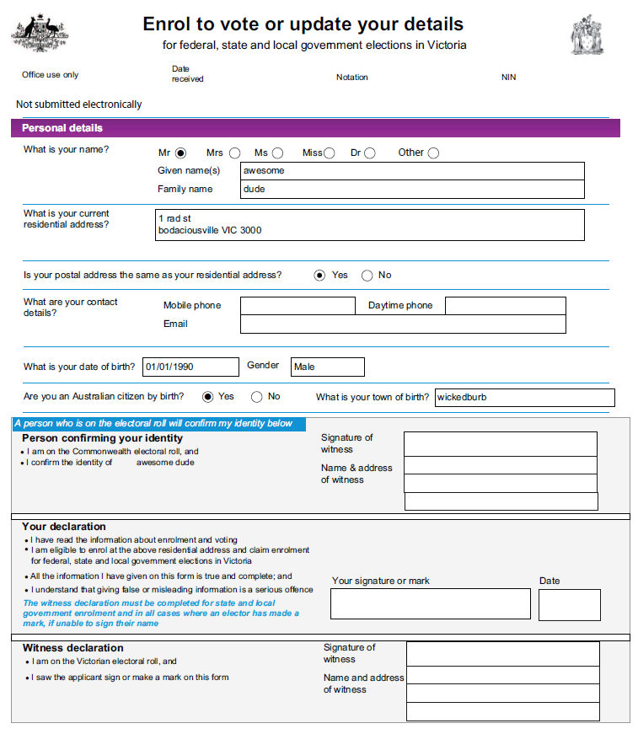
The node - the automatic bureaucrat
Bitcoin is basically a protocol. We’re creating forms and sending them from one to the other.
Each node receives the forms and process it in accordance to the pre defined conditions.
We can actually do everything using pen and paper!
Client

Slide 3
Bitcoin message – the form
Version header
Magic number | Command name | Payload size | Cehcksum
f9beb4d9 | version | 142 bytes | 61d65c7c
Version message payload
Version |  | 70012
services |  | 0x00
timestamp |  | 03 January 2017
Receiver |  | 127.0.0.1:8333
Sender |  | 127.0.0.1:8333
nonce |  | 123456789
. . . |  | . . .
Notes:
I can literally treat it as if it was a piece of paper

Slide 4

The Bitcoin protocol – Page one.
How to connect to another node:
Fill the “version message” form.
Send the version message to remote node
Wait for the remote node to replay
Bob
Incoming mail!
Bob wants to connect to the Bitcoin network.
Version header
Magic number | Command name | Payload size | Cehcksum
f9beb4d9 | version | 142 bytes | 61d65c7c
Version message payload
Version |  | 70012
services |  | 0x00
timestamp |  | 03 January 2017
Receiver |  | 127.0.0.1:8333
Sender |  | 127.0.0.1:8333
nonce |  | 123456789
. . . |  | . . .
Charlie
No blockchain yet. He can even send this message using owls mail

Slide 5
The Bitcoin protocol – Page Two.
Look at the version message you received from the remote node. If the information in the form is correct you can choose to connect to that remote node by constructing young own version message and send it back.
Follow the replay version message with a verAck message
If you received varAck message, replay by sending your own varAck message.
Version header
Magic number | Command name | Payload size | Cehcksum
f9beb4d9 | version | 142 bytes | 61d65c7c
Version message payload
Version |  | 70012
services |  | 0x00
timestamp |  | 03 January 2017
Receiver |  | 127.0.0.1:8333
Sender |  | 127.0.0.1:8333
nonce |  | 123456789
. . . |  | . . .
Bob
New Version message
New Version message
Charlie
verAck message

Slide 6
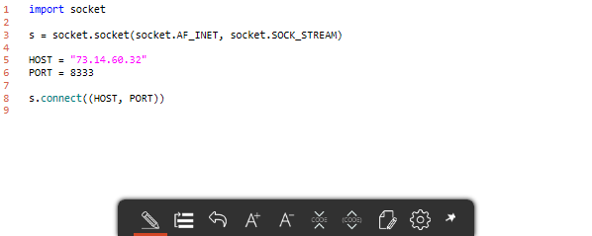
Blockchiain.info is a blockchain dedicated website that display a relatively updated list of available nodes - Available nodes
Simple python connection code

